Slide 1
ML-Assisted
RFIC Design Enablement: The New Frontier of AI for EDA
ASPDAC 2025: Invited paper
Hyunsu Chae¹, Song Hang Chai¹, Taiyun Chi², Sensen Li¹, and David Z. Pan¹
¹University of Texas at Austin, Austin, Texas, USA
²Rice University, Houston, Texas, USA
1
Notes:
`

Slide 2
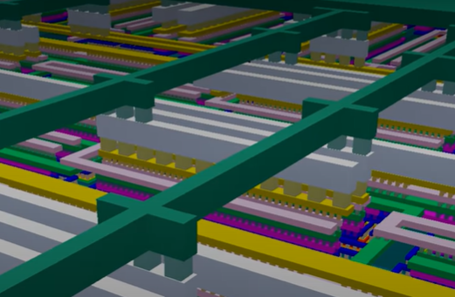
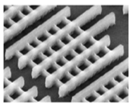
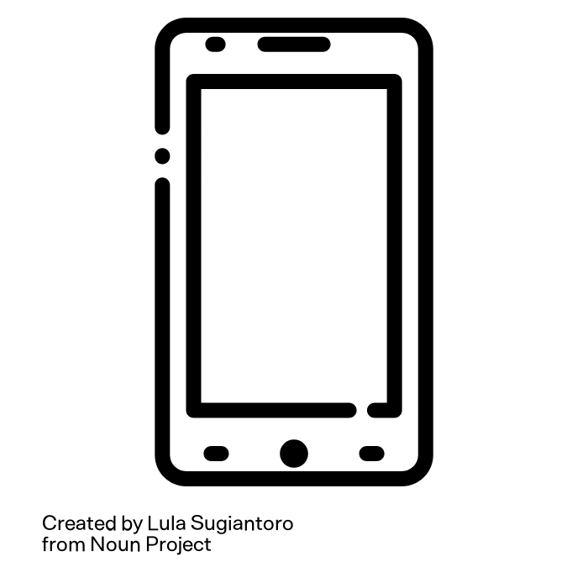



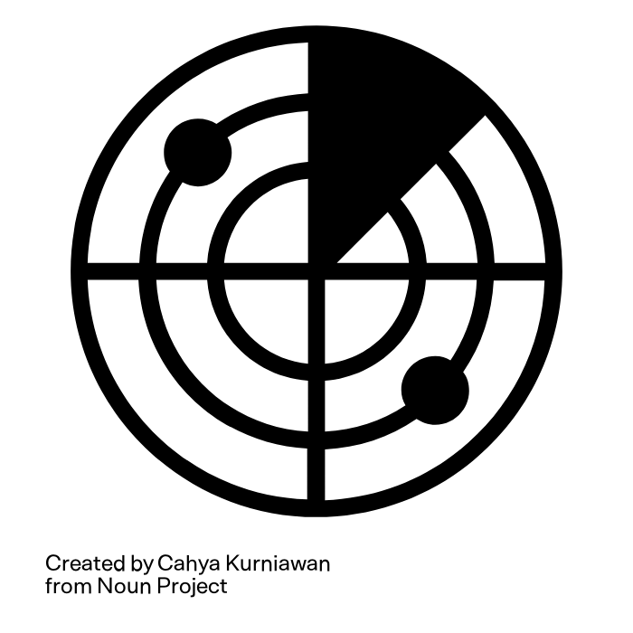
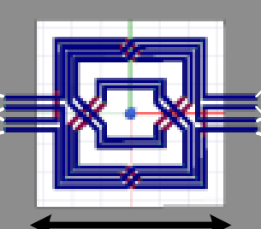
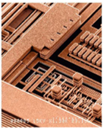
RFIC (Radio Frequency Integrated Circuit)
RFIC components are fundamental in wireless systems
RFIC = active + passive components
Active Components
Passive Components
[Behzad Razavi, RF Microelectronics]
Notes:
RFICs are essential in our daily lives, powering the wireless systems in devices like from smartphones and WiFi routers to satellite communication and radar.
RF circuit design can be divided into two objectives, active component design and passive component design.

Slide 3
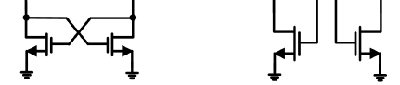
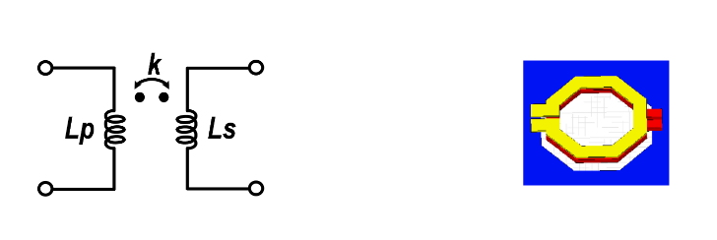
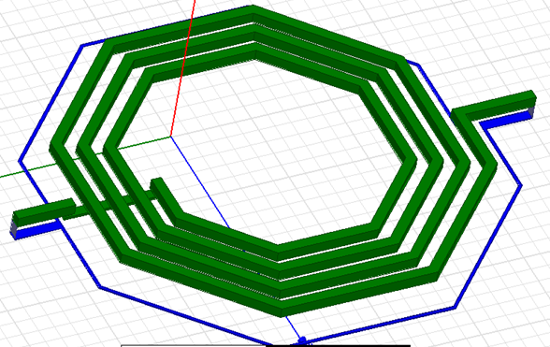
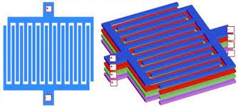
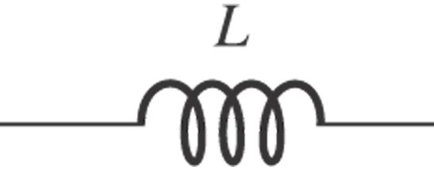
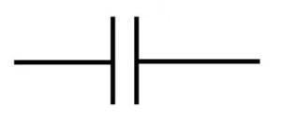
RFIC = Active + Passive
Active-Passive interactions influence the overall RFIC performance
Active Components
Provides the essential power and gain
Signal generation, amplification,…
Passive Components
Define the frequency response
Impedance matching, filtering, phase shifting, stabilization, harmonic manipulation,…
C
The majority of RFIC design efforts are focused on passive design and optimization
Notes:
This interaction between the active and passive component influence the overall RFIC performance.
The active components consists of ~~~ in charge of ~~~~~
The passive components consists of ~~~ in charge of ~~~~~
Currently, the majority of RFIC design efforts are focused on passive design and optimization and this will be our focus in today’s talk.

Slide 4
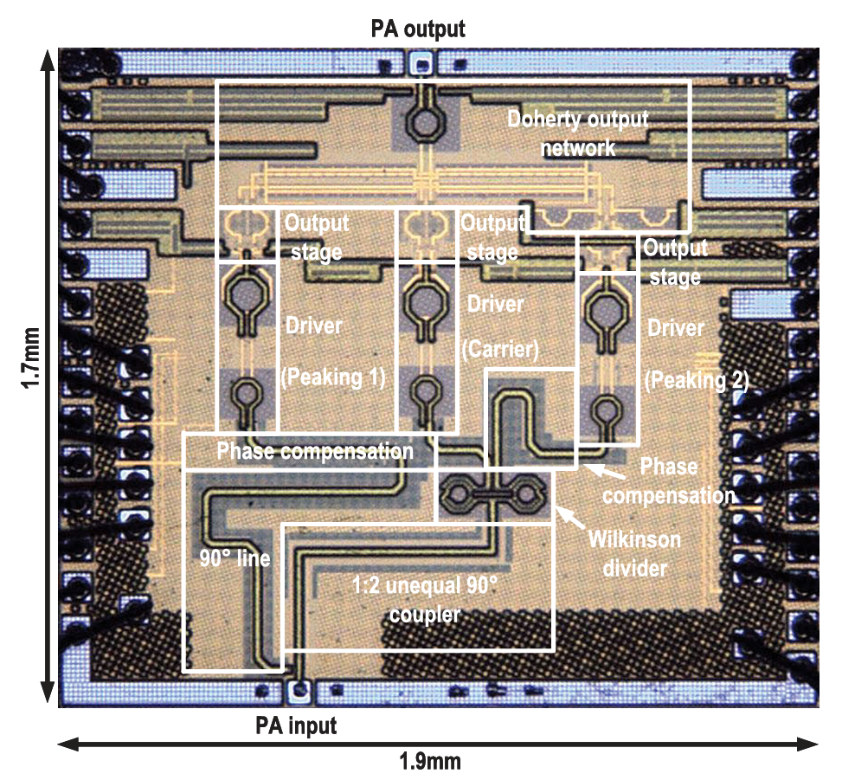
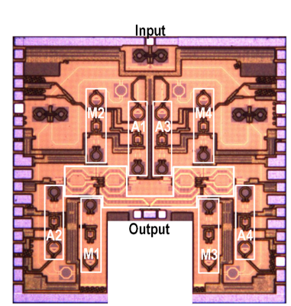
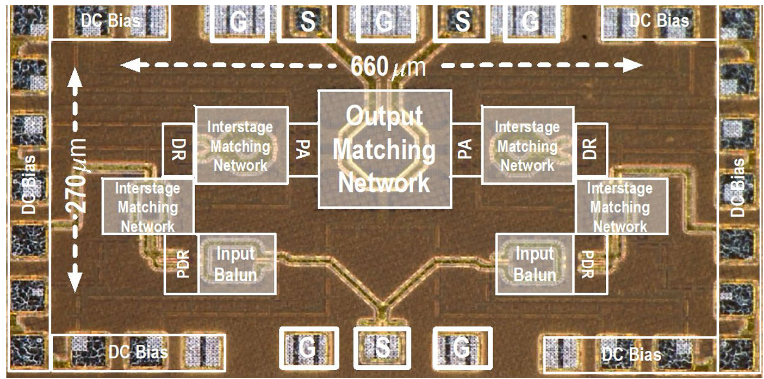
RFIC Passive Design Challenges
Need to balance different design objectives across frequencies
Minimize loss, maximize bandwidth, address impedance transformation
Follows active component design and can limit their performance
Occupy most of chip area
e.g., the passive component in an RF power amplifier (PA) occupies over 80% of the core chip area
Actives
[Zhang+, JSSC’23]
[Zhang+, TMTT’23]
[Li+, JSSC’24]
Notes:
The RFIC passive components have distinctive nature as it not only transfer signals but also handle high-frequency demands.
( It need to handle parasitic effects, electromagnetic interference (EMI), signal integrity (SI), and other non-idealities. )
When designing, we need to consider and balance different design objectives across frequency range. To minimize loss, ~~~
Passive design typically follows the selection of active components, with the design goals set according to the chosen actives.
The poorly designed passive will ultimately limit the performance of active components.
The passive networks occupies most of the area.
If you see in the layouts from three recent papers on RF power ampliers, the red highlighted area are occupied by the actives.

Slide 5
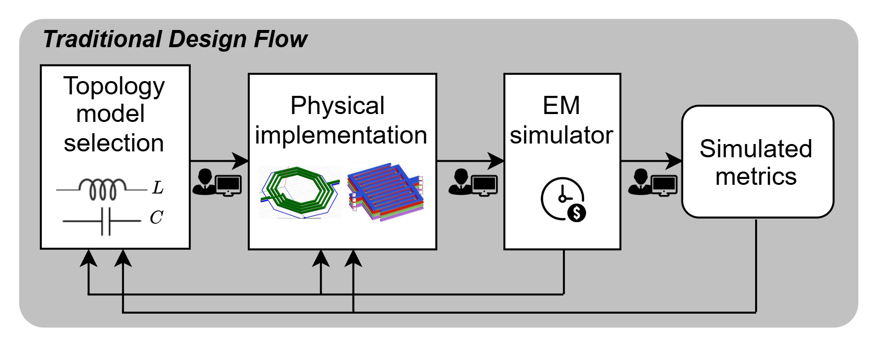
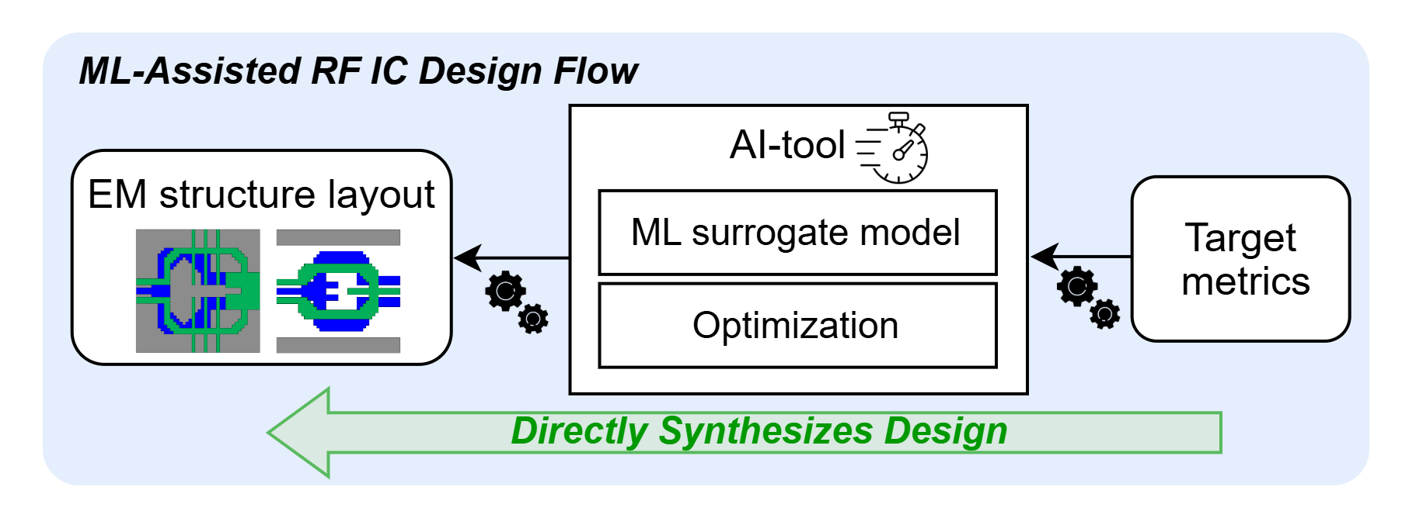
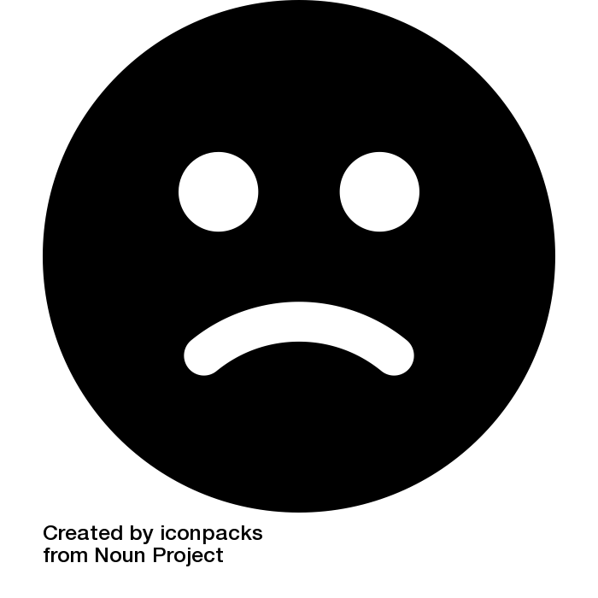

RFIC Passive Design Flow
Computationally expensive simulations
Iterative
Heuristically-constrained
High entry barriers for new designers
Fast evaluation utilizing ML models
Automated
Non-intuitive and beyond human
Lowered entry barriers for new designers
Notes:
The traditional RF passive design flow start from by selecting a well modeled topology, that consists of inductors and capacitances.
Then the designer map the parameters to an actual physical implementation.
This design is evaluated using computationally expensive EM simulator.
Then designers iteratively tune the physical geometry to address the discrepancy between target and simulated metrics.
Therefore, the optimization is confined to a limited set of topology templates and sequential heuristic decisions we make along the way.
It is very experience-based and has high entry barriers for new designers to learn these heuristics.
The ML-assisted flow on the other hand, can address these challenges.
AI-tool directly generates the design layout when given a target performance metrics.
The ML-surrogate model enables fast evaluation of performance and optimization method automates the design process.
With a more broader definition of design space outside just the template based, the AI-driven framework generate non-intuitive and beyond human designs.
And lower the entry barriers for new designers.
In this presentation, we will review recent advancements in two key components of the ML-assisted design flow: ML-surrogate models and optimization methods.

Slide 6
RFIC Passive Design Flow
Computationally expensive simulations
Iterative
Heuristically-constrained
High entry barriers for new designers
Fast evaluation utilizing ML models
Automated
Non-intuitive and beyond human
Lowered entry barriers for new designers
Notes:
First we will go over the ML surrogate modeling.

Slide 7
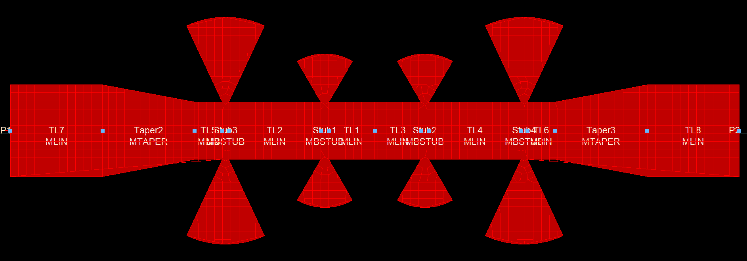
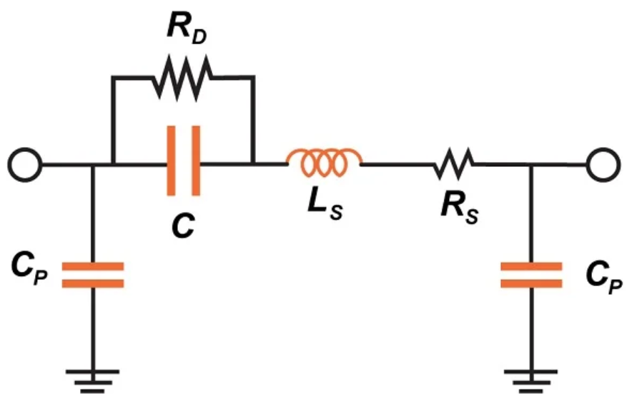
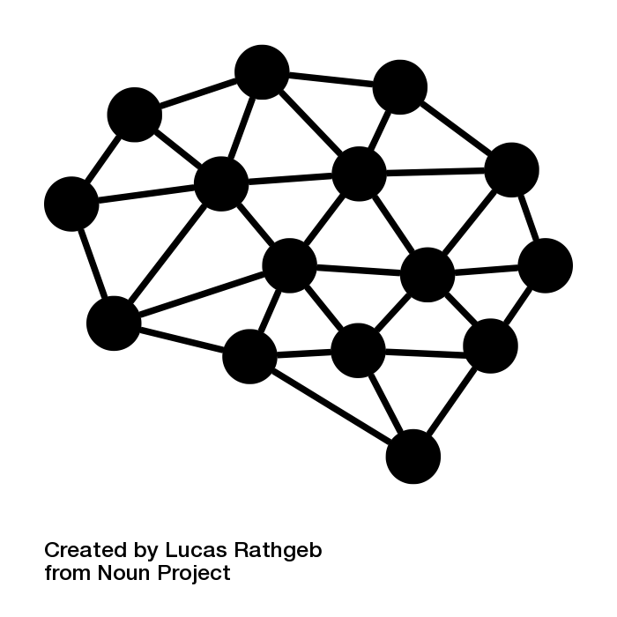
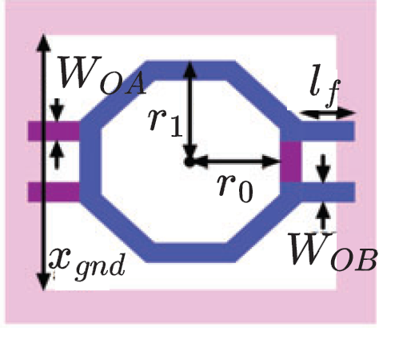
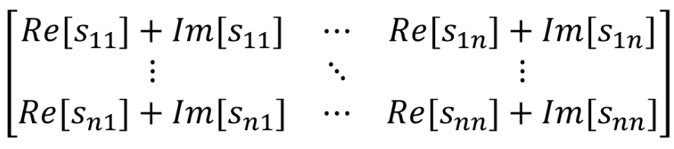
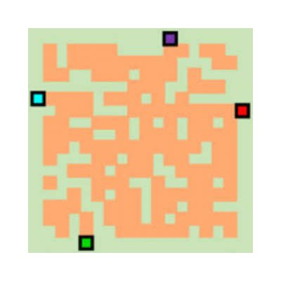
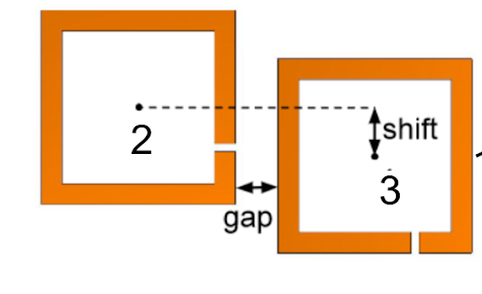
ML Surrogate Modeling
EM simulation is the major bottleneck of RF manual design
Solves Maxwell’s equations with 3D mesh
Replace EM simulation with ML surrogate models for faster performance evaluation
Passive Designs
ML Surrogate Model
RF
Passive
Designs
S-parameters
Notes:
EM simulation is the major bottleneck of RF manual design.
Conventional EM solver, such as Ansys HFSS employs numerical methods to solve Maxwell’s equations.
(They construct a 3D mesh of the entire simulation domain and divides it into small elements to approximate the field distribution.
HFSS iteratively refines the mesh based on field gradients until convergence criteria are met.
As the complexity of the design grows, so do the memory and computation demands due to the iteration required for convergence.)
The idea of ML surrogate model is to replace the EM simulation and enable faster performance evaluation.
The ML model will mimic what the EM simulation does, by taking the passive designs as input and output S-parameter matrix over frequencies.

Slide 8
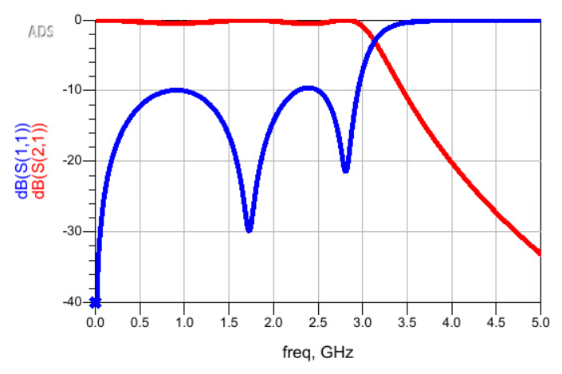
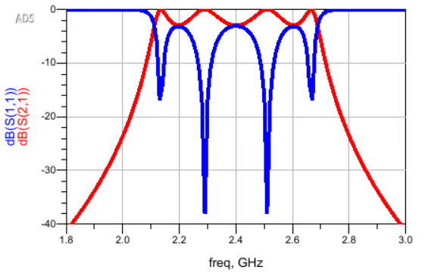
ML Surrogate Modeling
S-parameters (Scattering parameters)
Low Pass Filter
Describes the electrical behavior of a multi-port network
Characterizes the voltage (power) being transferred between ports
Matrix of complex numbers over frequency
Can be converted to Z, Y-parameters or other metrics to analyze various characteristics
Band Pass Filter
Limited research on ML surrogate modeling for RF passive designs..
Include reviews of related works in package design
Notes:
To quickly review what is Scattering Parameters…
We include reviews of related works in package design for predicting S-parameters in general.

Slide 9
ML Surrogate Modeling
Categorize based on different representations
Tabular (or Template) Based ML Modeling
EM structures are represented using predefined templates and parameter sets (physical dimensions, material properties,..)
Graph Based ML Modeling
Metal traces in the EM structures are segmented to form graph representations
Image Based ML Modeling
RF passive layouts are converted into layers of pixelated images representing metal or non-metal regions

Slide 10
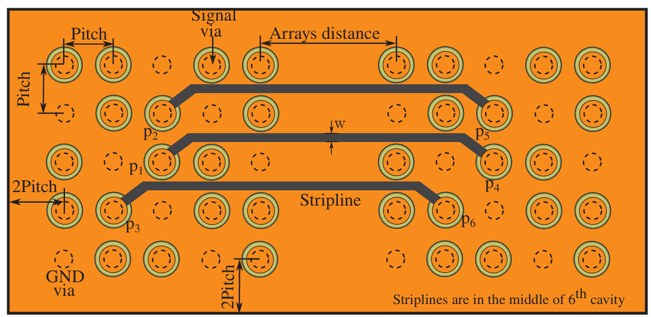
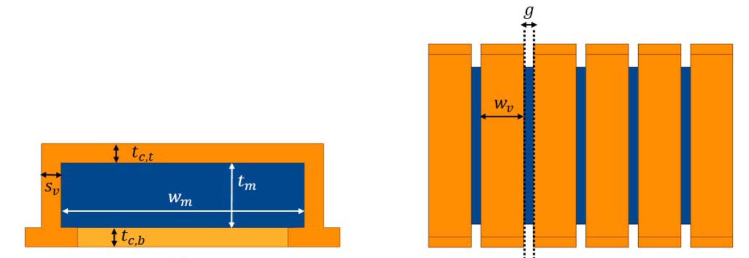
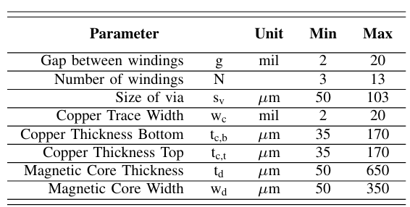
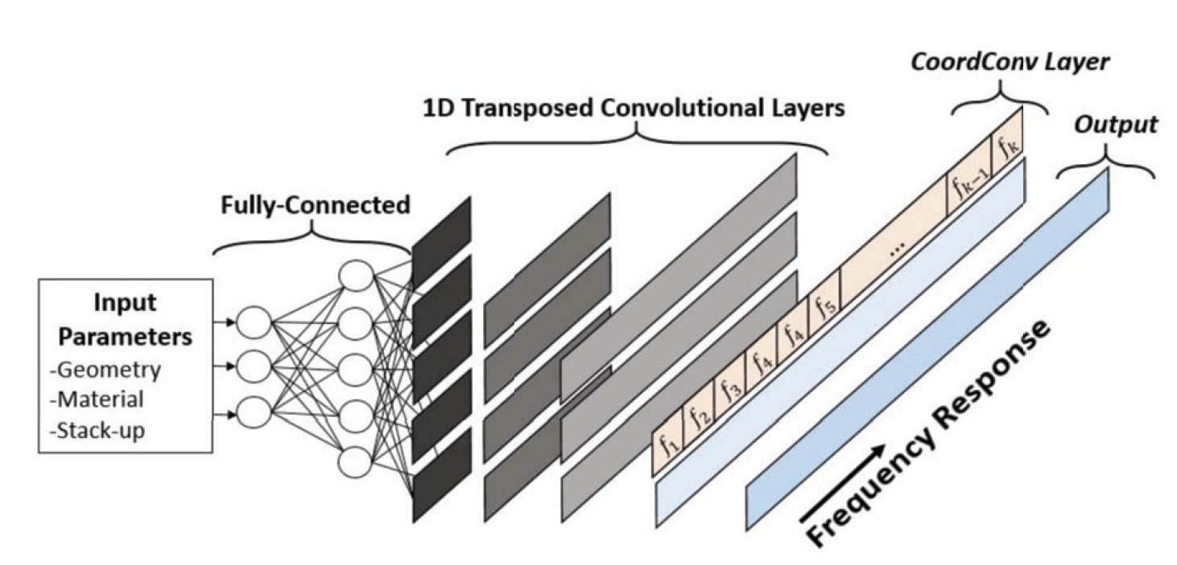
Tabular (or Template) Based ML Modeling
[Sánchez-Masís+, LAMC’23]
[Torun+, ICCAD’19]
cavity height (h) | 9±3mils
pitch | 40±20mils
pad radius (pr) | 9.25±2.75mils
antipad radius (ar) | 14.75±4.25mils
loss tangent (δ) | {0.002, 0.02, 0.2}
plate thickness (t) | {1, 2}mils
stripline width (w) | 5.5± 1.5mils
distance between arrays (d) | 10.5±9.5cm
relative permittivity (εr) | 4.1 ±0.3
Parameterizes PCB link between vias
Multi-layer perceptron (MLP) model for a frequency point
Parameterizes solenoidal inductor
Transposed-CNN model for across multiple frequencies
Notes:
Key contribution of this work is using the transposed-CNN model for the tabular input to predict S-parameter across multiple frequencies.
The transposed convolutional layers are introduced
Because the tabular inputs consist of a small number of parameters, but the output requires a higher dimensional representation..
So the transposed layer does something kind of opposite of conventional convolutional layer and expand the dimentionality.

Slide 11
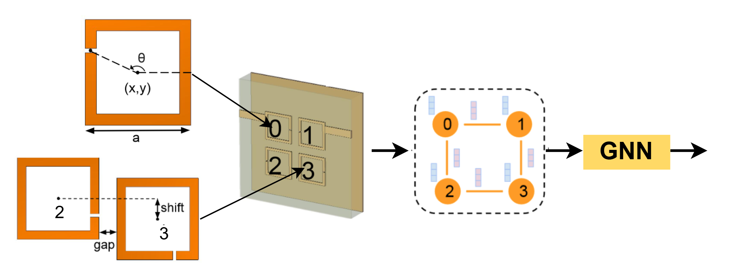
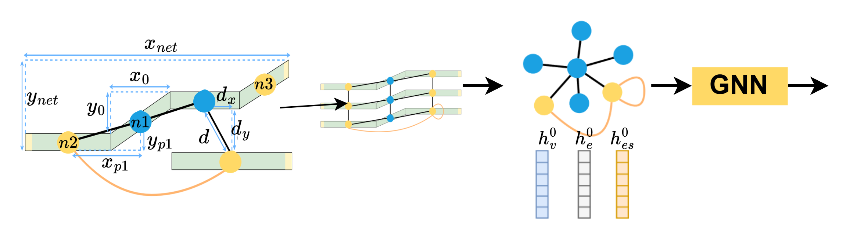
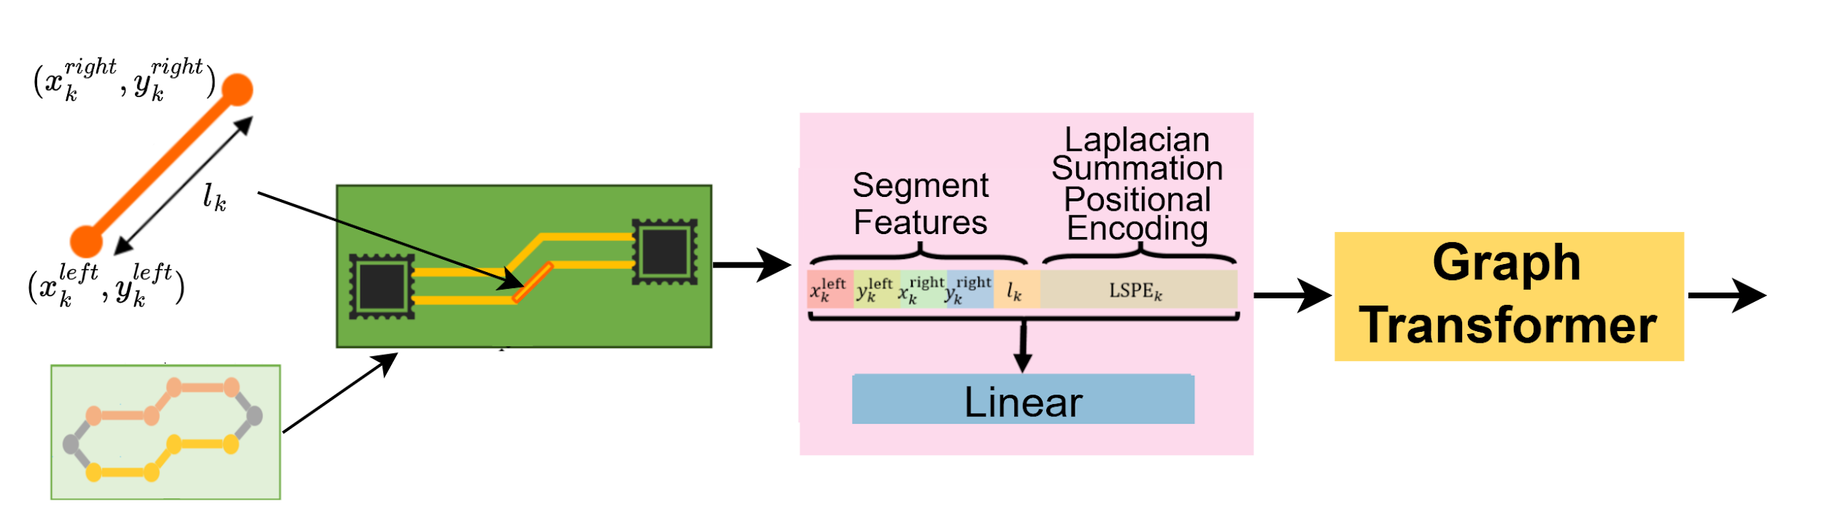
Graph Based ML Modeling
[Zhang+, ICML’19]
Represents 𝑁-resonator filter as graph
Nodes : resonators (center coordinates, etc. )
Edges: electromagnetic interaction between resonators
GNN model
[Liu+, TCPMT’24]
Represents PCB interconnect (UCIe) as graph
Nodes : each segmentation
Edges: connection between segmentations
GNN model
[Kim+, DAC’24 ]
Represents PCB interconnect as graph
Graph Transformer model

Slide 12
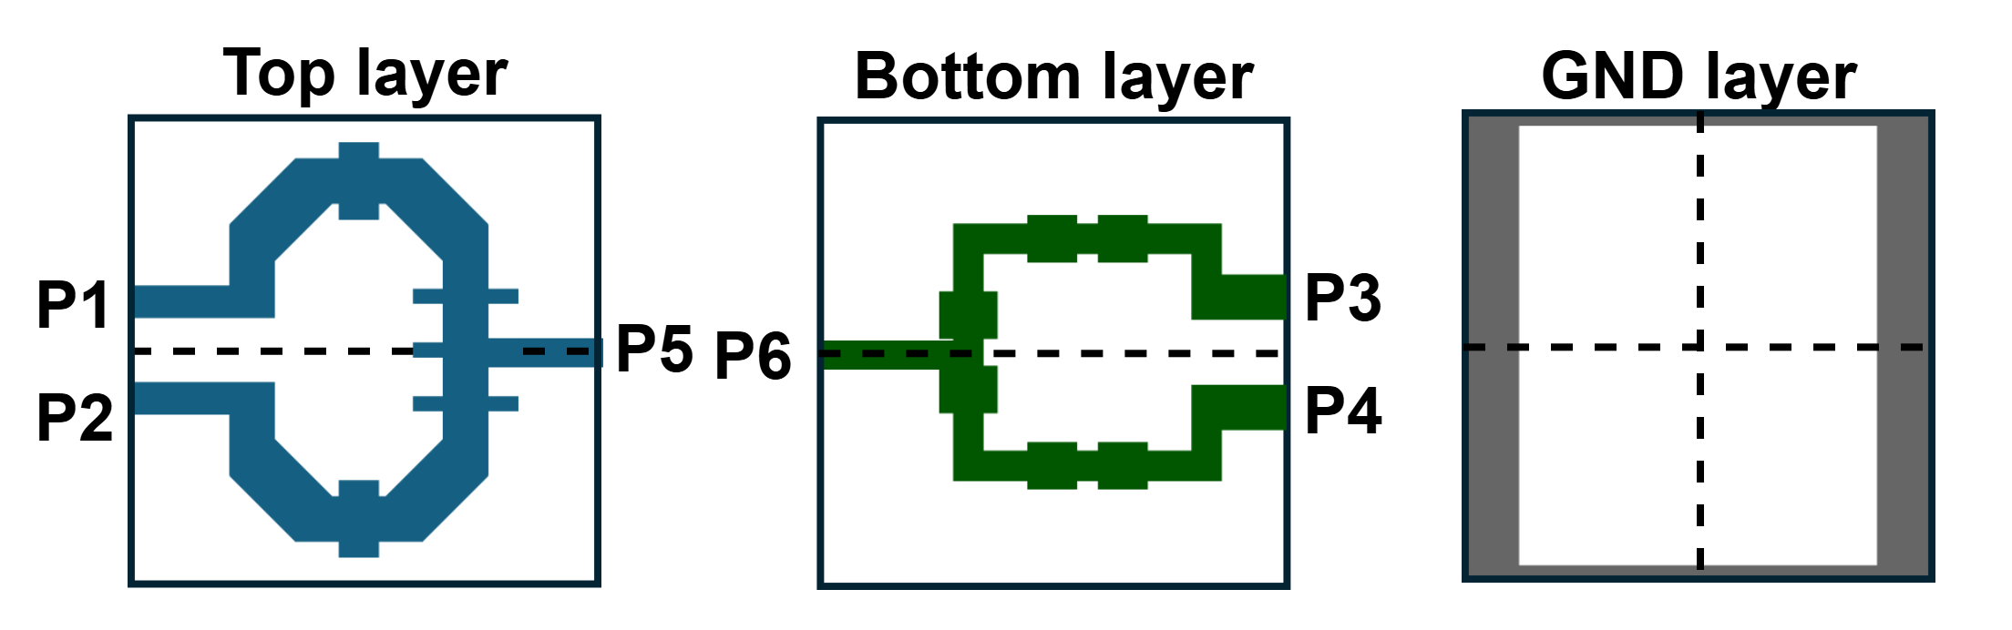
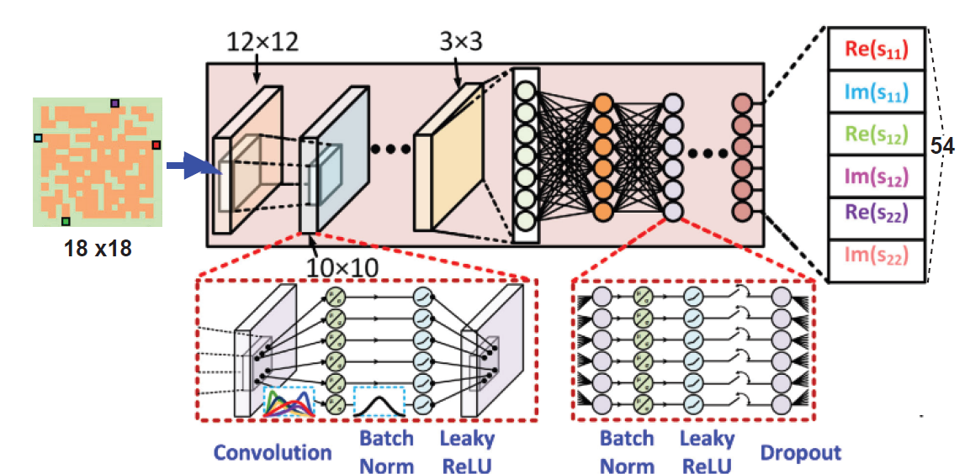
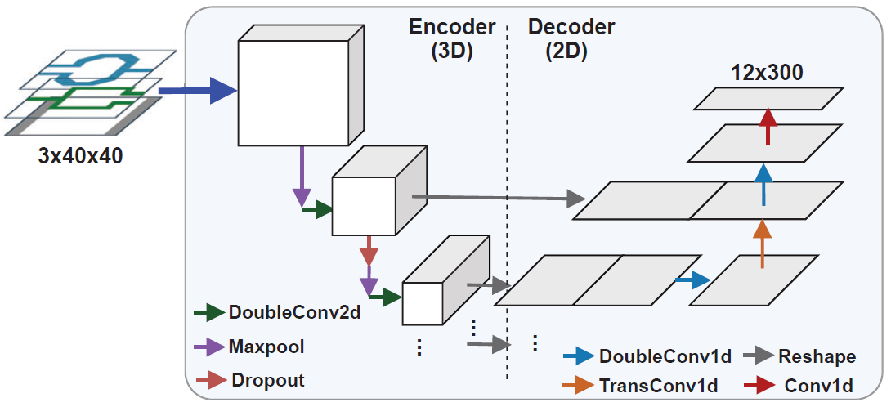
Image Based ML Modeling
[Karahan+, JSSC’23]
[Chae+, ICCAD’24]
Single-layer layout (pixelated to 18x18) for matching network
Deep-CNN model
Multi-layer layout (pixelated to 3x40x40) for generic impedance transformation network
3D-to-2D UNet model
Notes:
This approach enables the application of various image processing techniques in the AI field. Can leveraging data augmentation strategies

Slide 13
ML Modeling: Challenges
Challenge: Representing solution space
Tabular: Requires a predefined fixed set of template parameters
Graph: Faces scalability issues as the trace segmentations increases
Image: Demands significant computational resources
Performance comparison is difficult
Challenge: Quality and quantity of the dataset
Limited open datasets: NDA constraints from semiconductor foundries limits open-source RFIC datasets
Costly dataset generation: Training datasets rely on expensive and time-consuming EM simulations
Notes:
each approach is suitable for different application, requiring more studies
More general challenge is
ML model performance essentially depends highly on the quality and quatity of the dataset

Slide 14
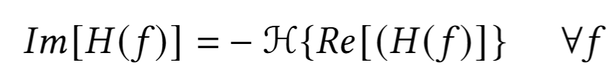
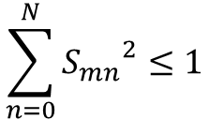
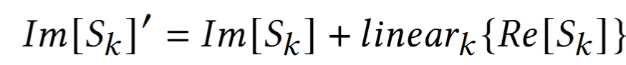
ML Modeling: Future Directions
Current Key Contributions: Physics-augmented ML modeling
Reduce data dependency by integrating physical knowledge with ML
Causality Enforcement Layer :
Passivity Enforcement Layer:
Kramer-Kronig Compensation Layer:
Future Directions:
Further exploration of methods to embed physical law into ML model
Use of fast solvers with optimal complexity and transfer learning for technology-agnostic applications
Development of open-source datasets
[Torun+, TMTT’20]
[Chae+, ICCAD’24]
Notes:
Shows promising result in increasing accuracy and dataset required for model training.

Slide 15
RFIC Passive Design Flow
Computationally expensive simulations
Iterative
Heuristically-constrained
High entry barriers for new designers
Fast evaluation utilizing ML models
Automated
Non-intuitive and beyond human
Lowered entry barriers for new designers

Slide 16
Inverse Design Optimization
Quickly synthesize RF passive design to satisfy the given target performance
Tabular Design Space Optimization
Pixelated Design Space Optimization
Hybrid (template and pixelated) Design Space Optimization
Notes:
The inverse design optimization stage utilizes the ML surrogate model for performance evaluation, and quickly synthesize a RF passive design that satisfy the target given by the designer.

Slide 17
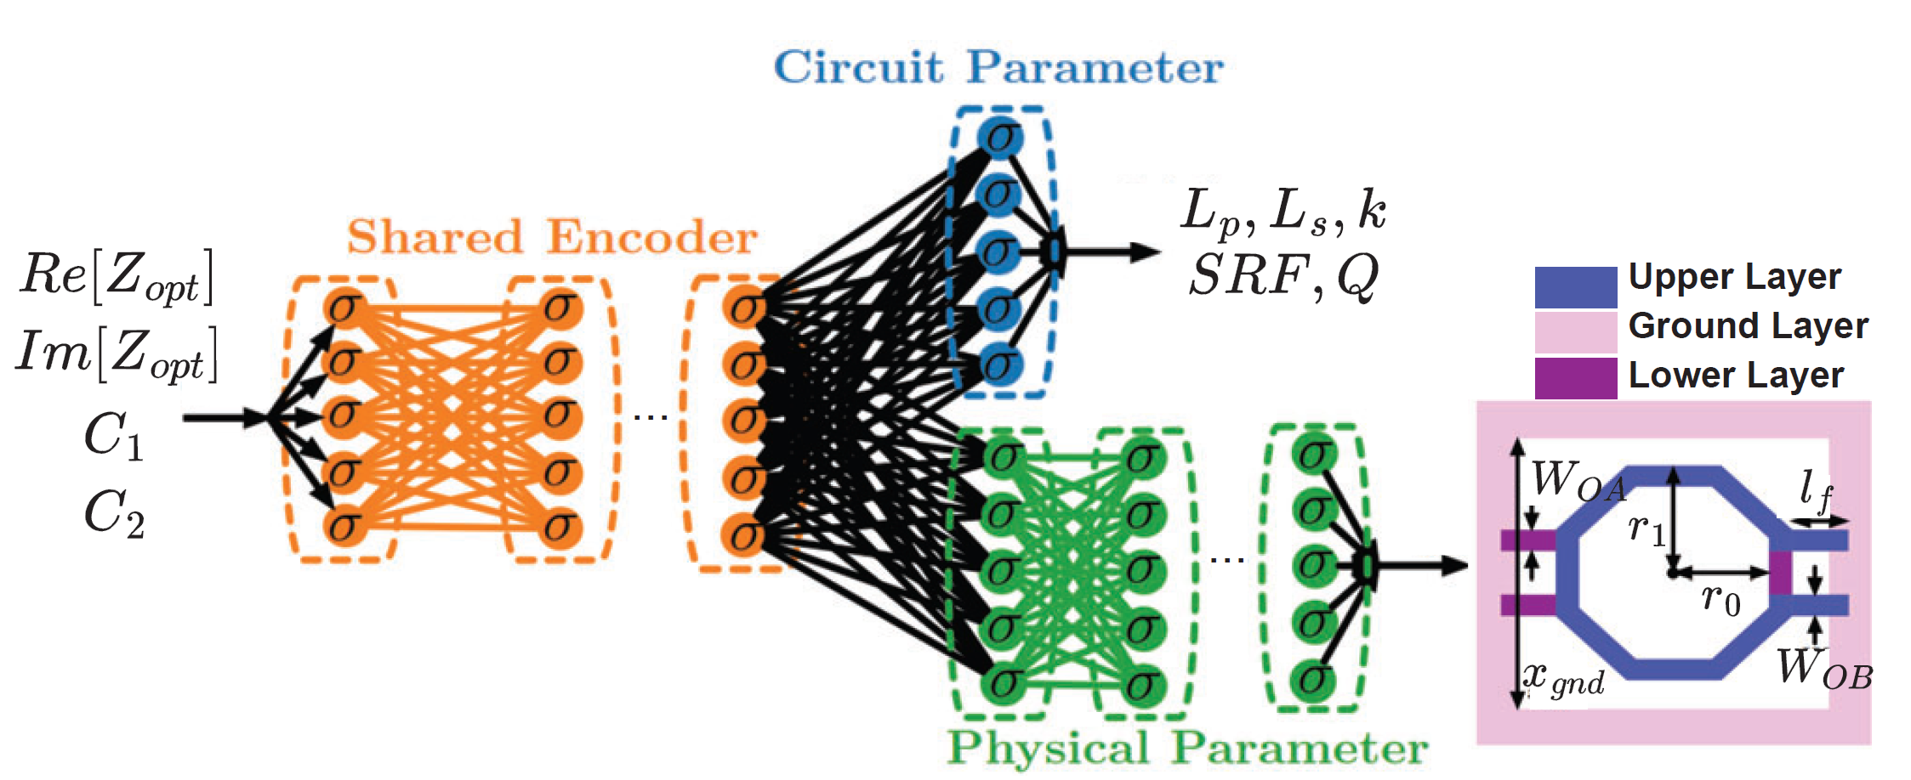
Tabular Design Space Optimization
Directly train ML model to predict the design parameters
ML model is trained to do the “inverse” design
Requires a strategy to resolve multi-modal output problem
[Er+, IMS’21]

Slide 18
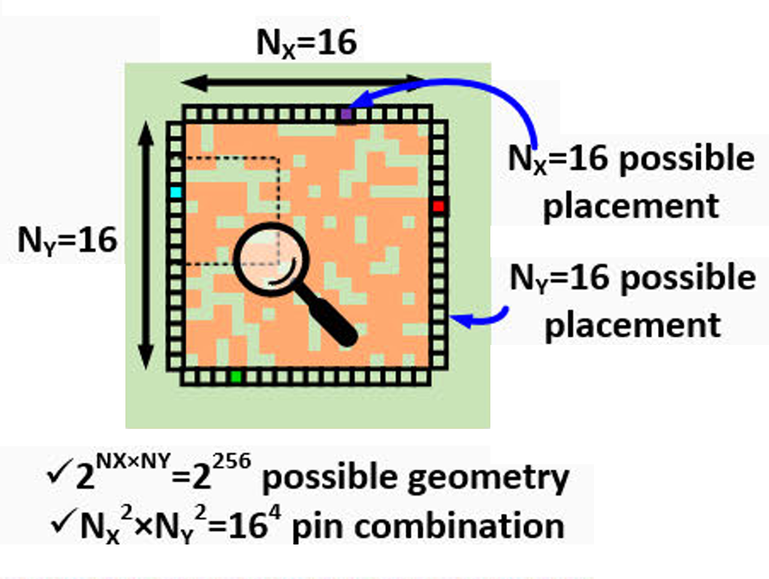
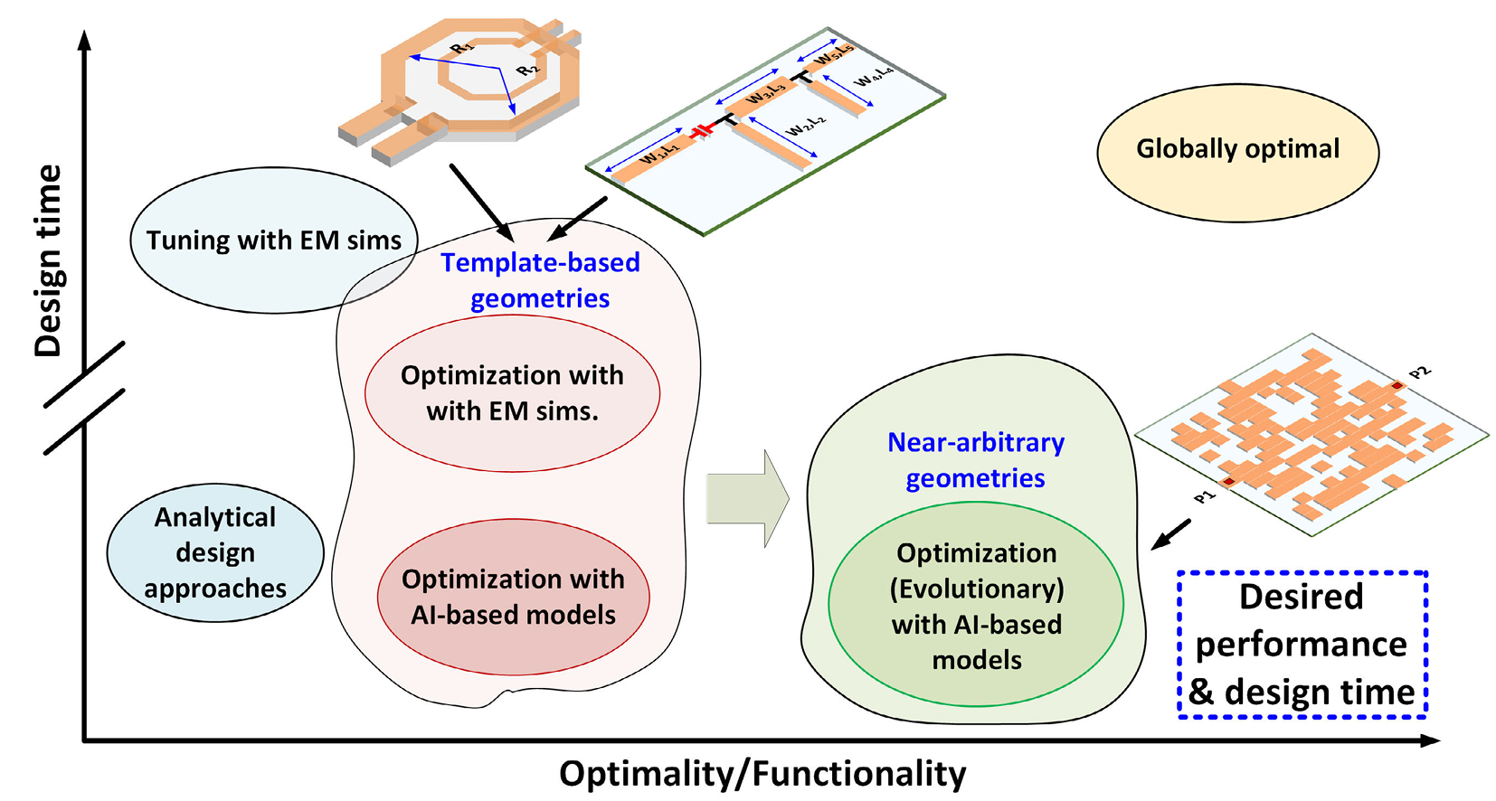
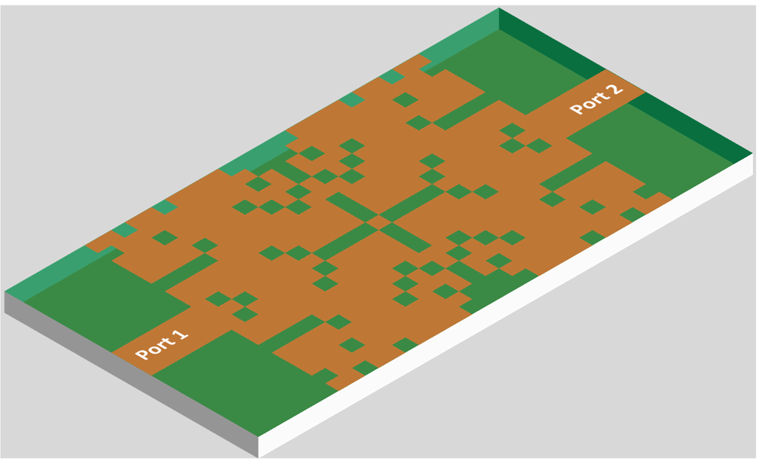
Pixelated Design Space Optimization
The entire design area is pixelated into bitmap of metal or non-metal
[Karahan+, JSSC’23]
[Karahan+, JSSC’23]
[Lee+, NEWCAS’23]

Slide 19
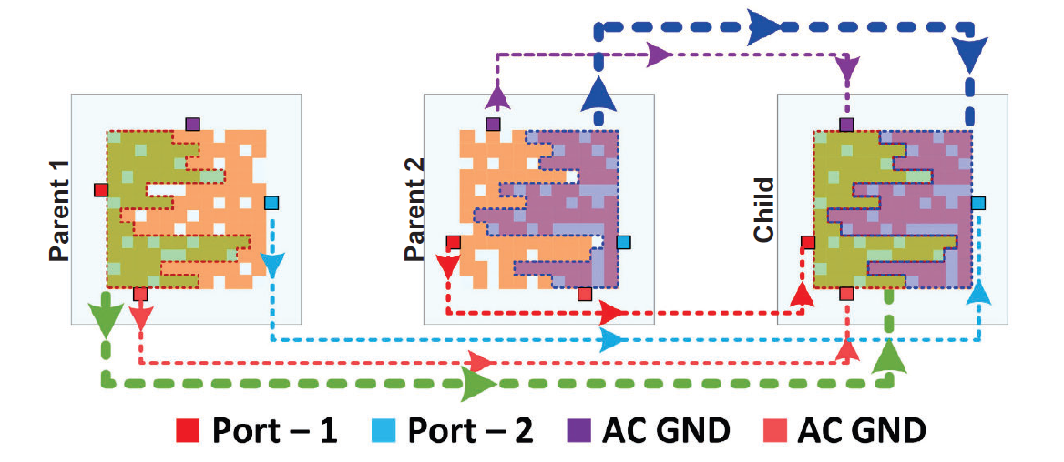
Pixelated Design Space Optimization
Genetic Algorithm-based Optimization
[Karahan+, JSSC’23]
Two best performing designs are selected from random set of designs
Offsprings are reconstructed from each parent through a random cut line
Random mutations on pixels are applied

Slide 20
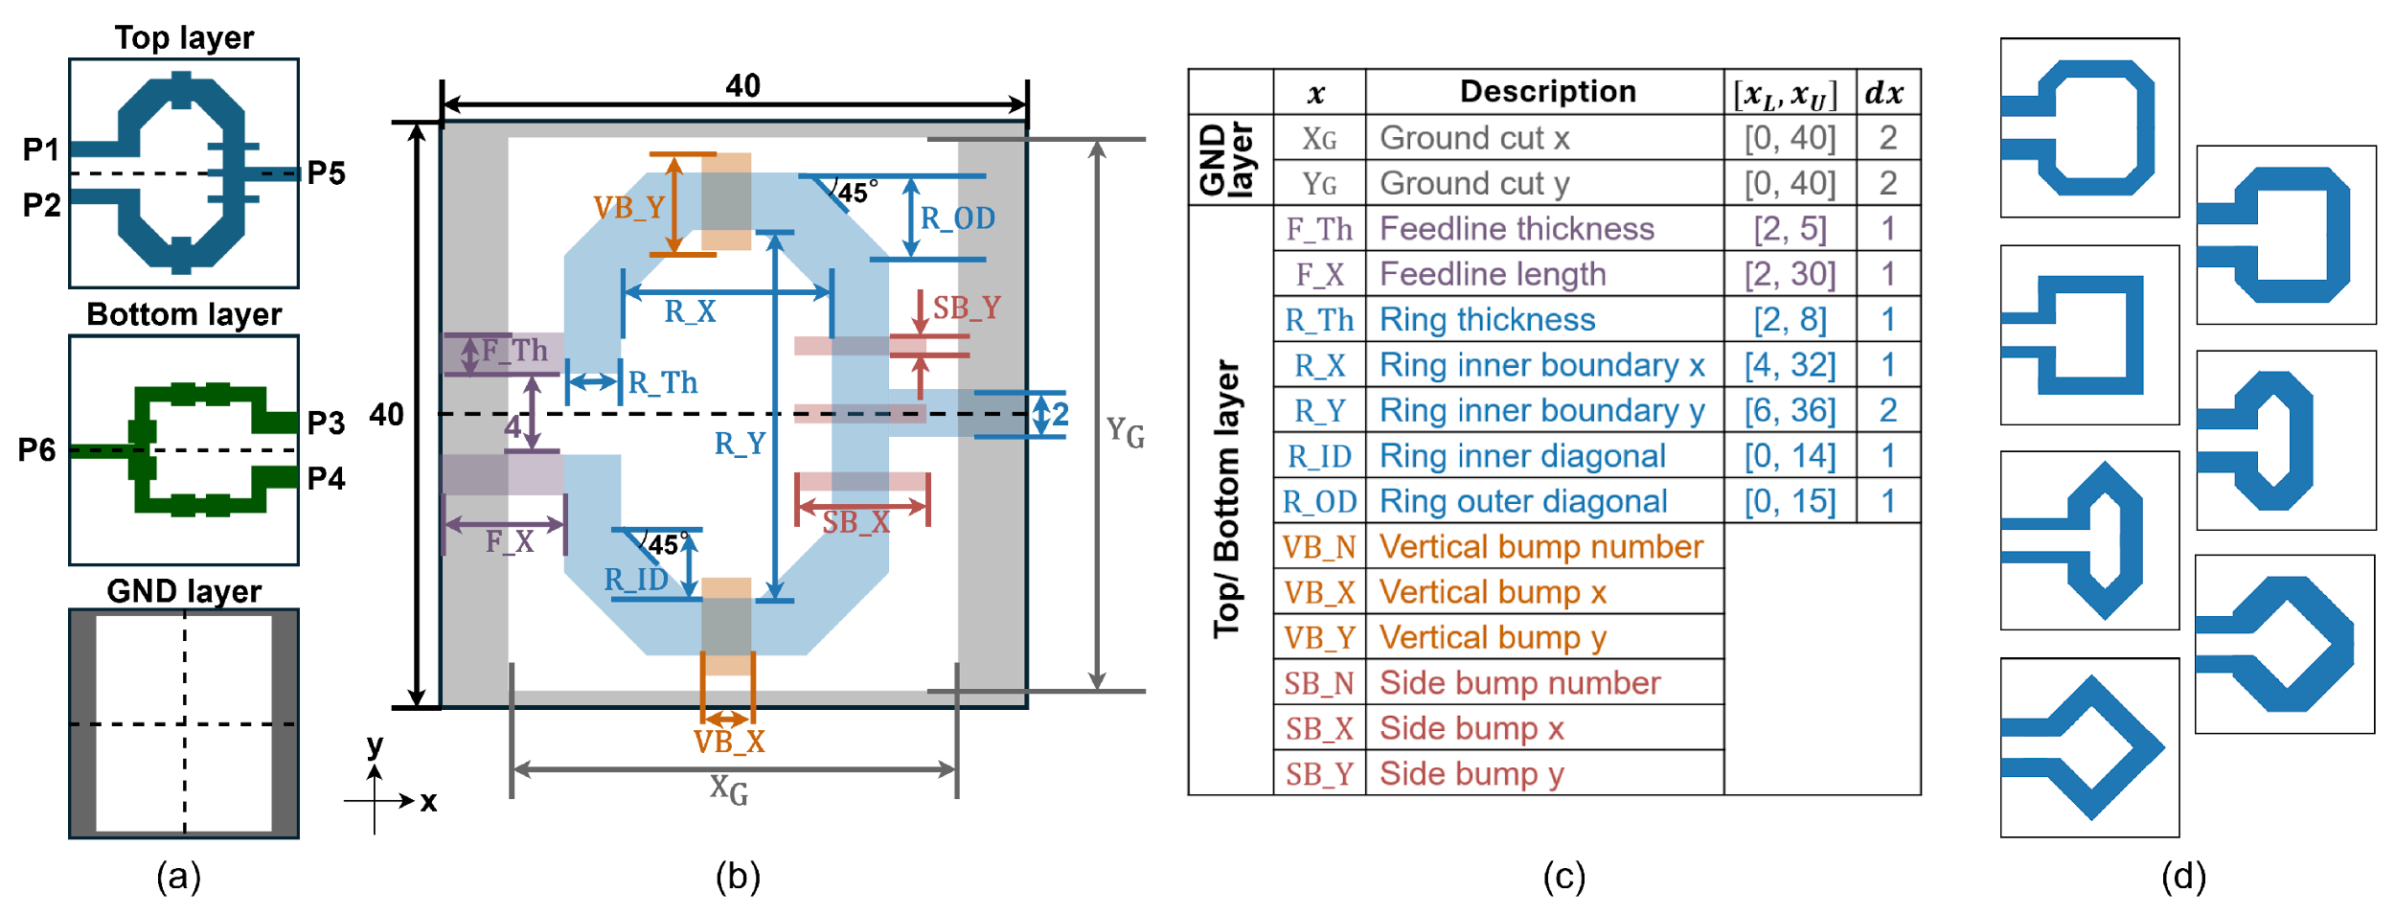


Hybrid Design Space Optimization
The design space is represented as the combination of conventional and pixelated approach
[Chae+, ICCAD’24]
28 parameters
Diverse ring shapes
Local deformations
Notes:
This design space is inspired by the traditional ring structures seen in inductor, transformer and coupler structure.
Several parameters represent the diverse ring shape, allowing for more flexibility compared to traditional octagonal rings.
Moreover, we add more parameters to represent the local deformation in the width of the ring to expands the design space even more with non-intuitive choices.

Slide 21
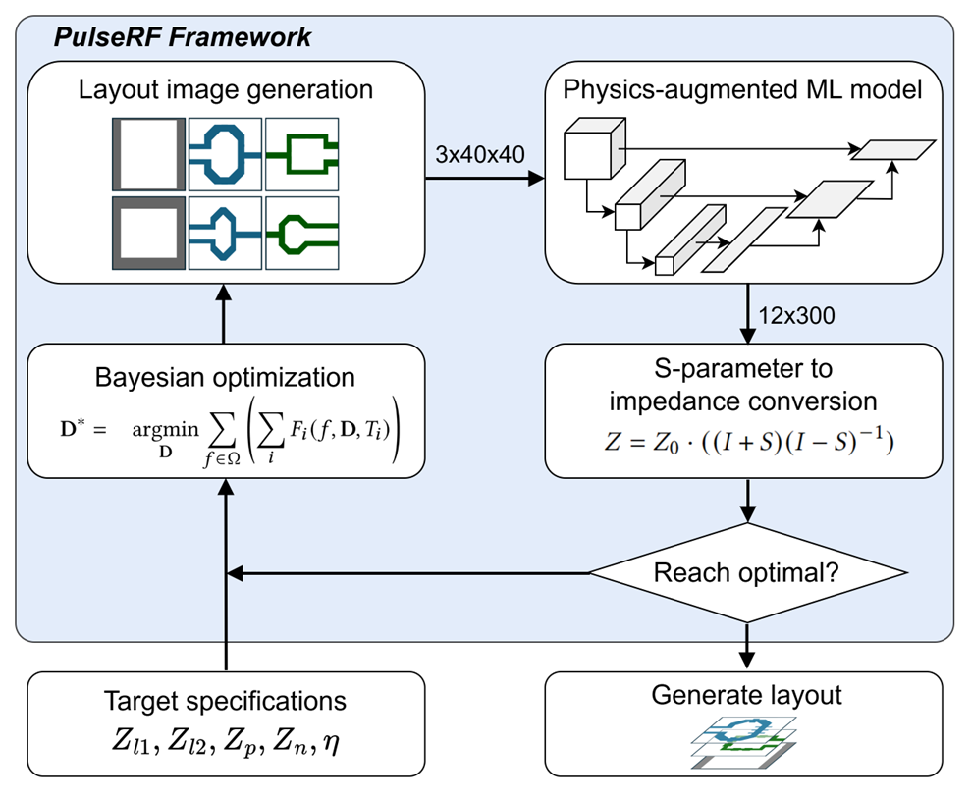
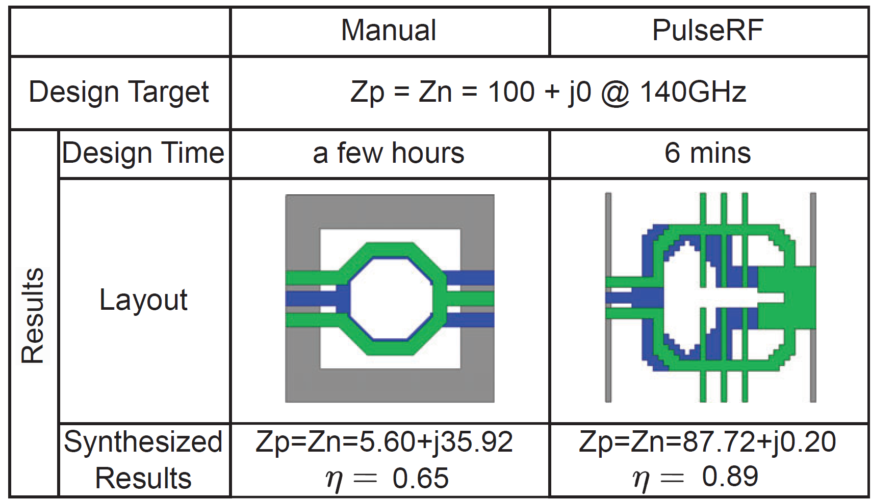
Hybrid Design Space Optimization
Bayesian Optimization
Select new designs through probabilistic decision-making
Optimize for ring-structure parameters
Local deformations are treated as noise
[Chae+, ICCAD’24]
Non-intuitive structure can achieve beyond template-based design
Notes:
The defined design space is then optimized with Bayesian optimization and probabilistic decision-making.
In this work, we specifically only optimized the design for ring structure parameters.
Introduced local deformations are treated as noise to the design to see if slight changes in the structure can lead to improved performance.
This is one of the highlighted result. You can see that the layout output of the framework is very not intuitive, and achieve the performance that cannot be achieved when relying on the predefined transformer behavior model in the manual design.

Slide 22
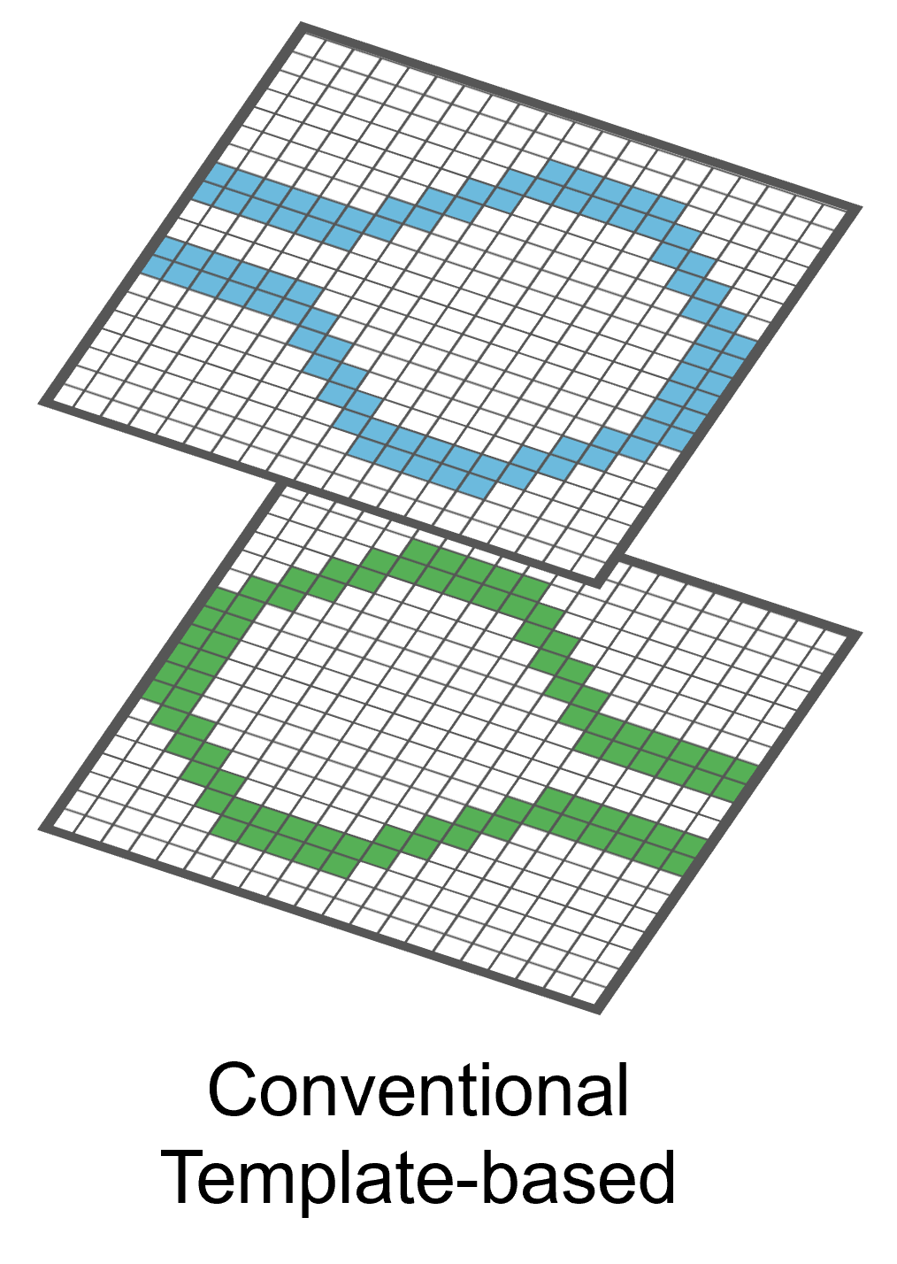
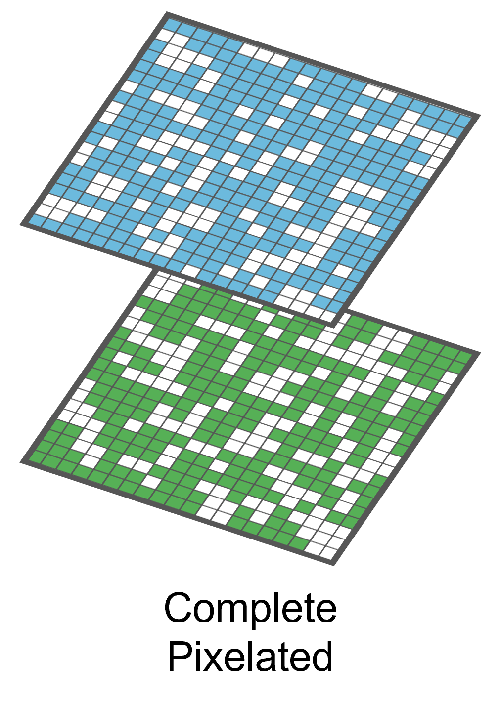

Inverse Design: Challenges
Challenge: Design space definition
Conventional tabular: highly restricted
Complete pixelated: randomly scattered pixels and isolated shapes lead to redundant design performance
→ Need to balance between exploitation and exploration of the design space
Solution:
Hybrid-approach of flexible template-based with local deformations
Notes:
Highly restricted in choices.
Complete pixelated approach can unnecessary generate a very complex design space and also, the randomly scattered pixels ~~~ can lead to redundant designs.

Slide 23

Inverse Design: Future Direction
Future Directions:
Incorporate RFIC domain knowledge to design space definition to ensure meaningful performance outcomes
Introduce non-intuitive features to enhance flexibility
Shift towards active-passive co-optimization, integrating both components into an end-to-end AI-assisted design flow
Active Device
Passive Network
Power
Amplifier
Active
Optimization
Passive
Optimization
Co-Optimization

Slide 24
Conclusion
We have just scratched the surface of AI for RF IC design automation
Won’t replace experienced designers, but will replace “mundane” jobs, improve productivity, democratize RF IC designs (workforce development)
A lot of future research opportunities: incorporating physic laws, transfer learning, technology-agnostic applications, explanability, optimality, active-passive co-optimization,..
Notes:
In summary, so far,
Improve productivity, drive innovation and

Slide 25


NSTC 1st Jump Start R&D Program: AIDRFIC
UT Austin led project “GENIE-RFIC: Generative ENgine for Intelligent and Expedited RFIC Design” selected
We are hiring PhD students and postdocs (please contact Prof. David Pan)
Notes:
launched

Slide 26
Thank You

Slide 27
Pros and Cons of Different Approaches
Depending on the representation of solution space
Tabular representation need to have a pre-defined fixed set of template parameters
Graph representation can have scalability issues as the number of trace segmentation increases
Image representation requires significant computational resources for storage, processing and training
Performance comparison is difficult, requiring further studies
Notes:
each approach is suitable for different application, requiring more studies

Slide 28
ML Modeling: Challenge and Future Directions
Challenge: Performance of ML surrogate models depends highly on quality and quantity of the dataset
No open-source RFIC datasets due to NDA constraints from semiconductor foundries
Training datasets are expensive to generate, relying on costly and time-consuming EM simulations
Solutions: Physics-augmented ML modeling
Reduce data dependency by integrating physical knowledge with ML
Combining empirical data with physical principles
Notes:
Integrating physical knowledge with ML to reduce dataset dependency
Combining empirical data with physical principles improves performance on tasks involving physical laws

Slide 29

ML Modeling: Challenge and Future Directions
Current Key Contributions:
Causality Enforcement Layer (CEL) :
Embeds the inherent real/imaginary relationships of s-parameters
Passivity Enforcement Layer (PEL):
Embeds the nature of energy non-generation in passive networks
Kramer-Kronig Compensation Layer (KKCL):
Addresses frequency discrepancies in imaginary components
[Torun+, TMTT’20]
[Torun+, TMTT’20]
[Chae+, ICCAD’24]
Notes:
PEL limiting the upper bound of sum of s-parameter for a port.
In frequency over 100GHz, the fine-grain HFSS simulated dataset presents a prominent discrepancy compared to the CEL-generated imaginary component
Alleviate the discretization error at higher frequency range

Slide 30




ML Modeling: Challenge and Future Directions
Future Directions:
Further exploration of methods to embed physical law into ML model architectures and training methods
Use of fast solvers with optimal complexity and transfer learning for technology-agnostic applications
Development of open-source datasets
Physics Knowledge
ML Model
$$∇∙\vec{E}=\frac{ρ}{ε_{o}}$$
$$∇∙\vec{B}=0$$
$$∇×\vec{E}=\frac{∂\vec{B}}{∂t}$$
$$∇×\vec{B}=μ_{o}\vec{J}+μ_{o}ε_{o}\frac{∂\vec{E}}{∂t}$$
Physics-Informed
Physics-Augmented
ML Model
Notes:
Scalability

